Slide 1



Graduation Project Examination System
(Group 1)

Slide 2
Project Idea
Constructing an examination automated system that can perform exams and build SQL database from scratch and generating some reports and dashboards that can help in making decision to improve educational environments.

Slide 3





Online Examination System
Amr Negm
Ahmed Elgayar
Mohamed Abdela
Mohamed Khouka

Slide 4
The Role For Each Team Member
Mohamed Khouka
Amr Negm
Mohamed Abdela
Ahmed Elgayar
0- Intro
1- ERD
2- Mapping
3- SQL, SP
4- SSIS
5- SSRS
6- Documentation of Database
7- Power BI
8- insights and business intelligence

Slide 5
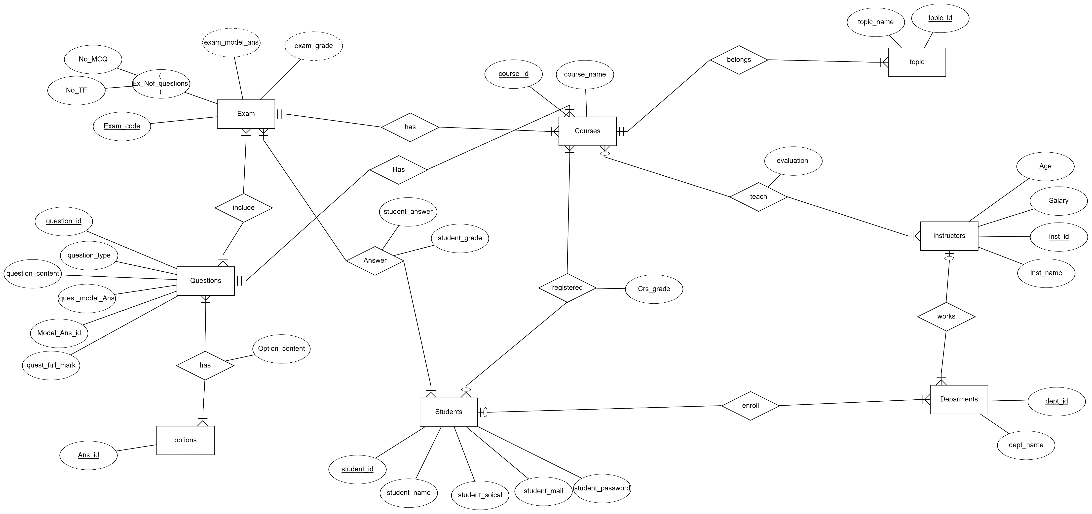
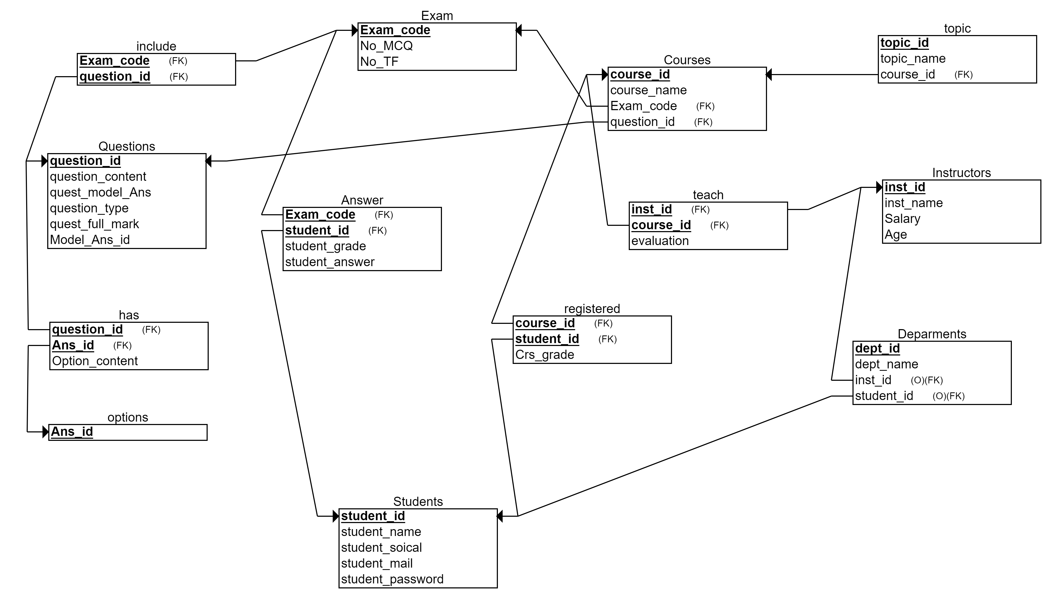
1- ERD
We use erdplus.Com for ERD and Diagram.

Slide 6
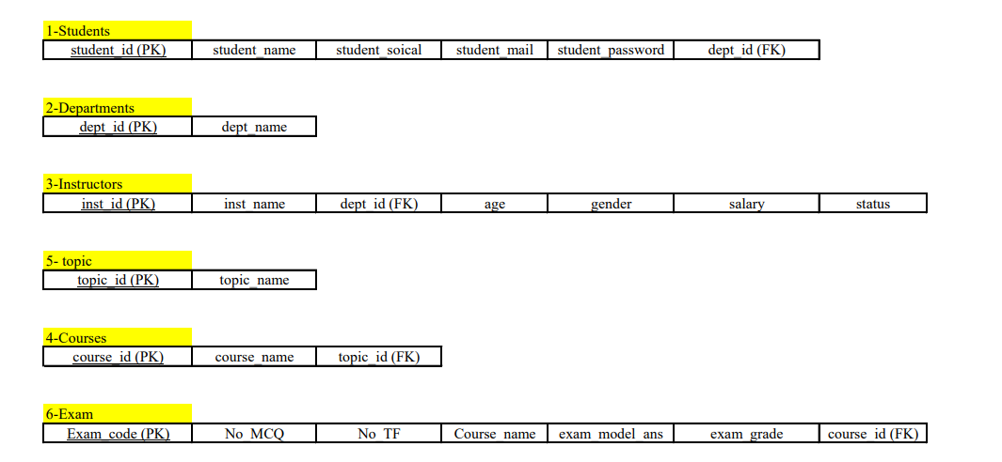
2- Mapping

Slide 7
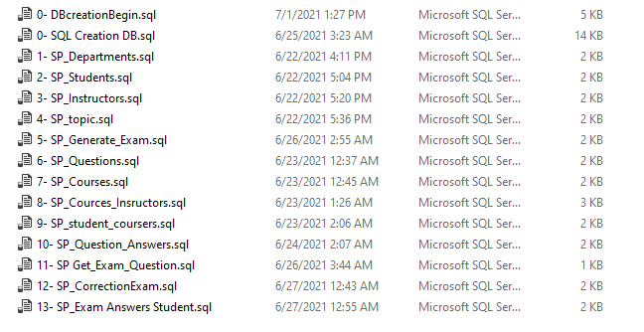
3- SQL & Stored Procedures

Slide 8
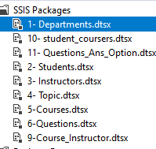
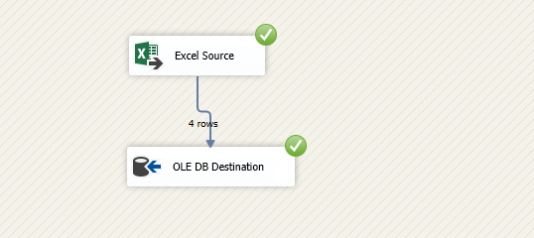
4- Data collection & SSIS

Slide 9
5- SSRS
Get Student Info By Department.
Take StudentID Return Grades Courses.
Take InstructorID Return Courses info.
Take CourseID Return Topic.
Take Exam_code Return Questions.
Take Exam_code Return student and answers info.

Slide 10
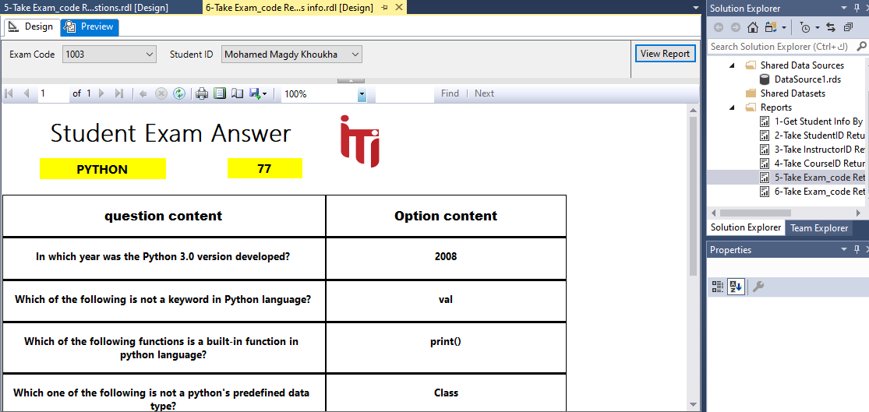
5- SSRS

Slide 11
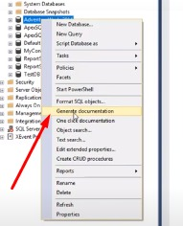

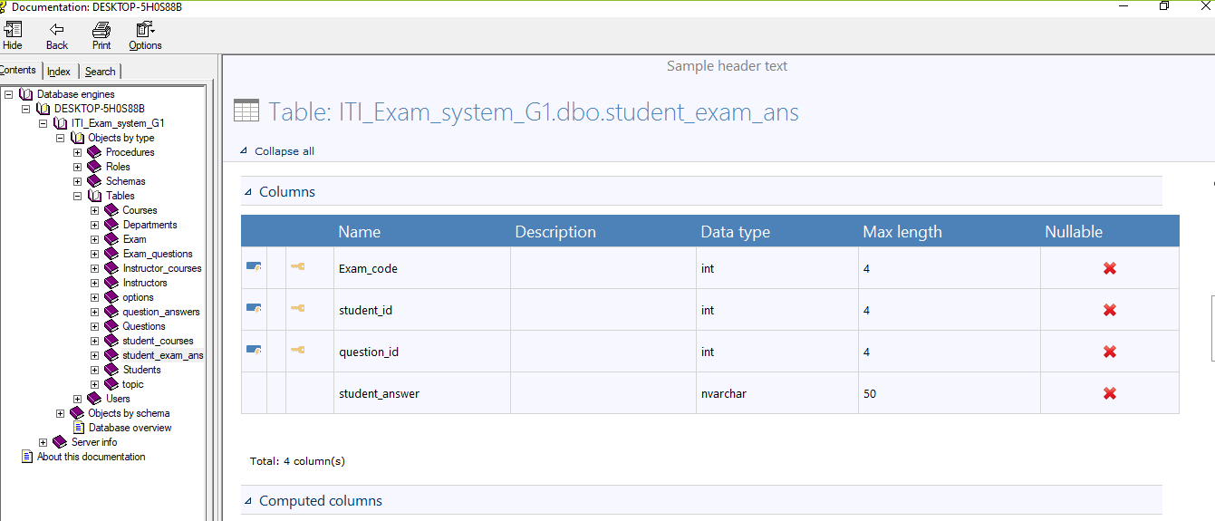
6- Documentation of Database
We use ApexSQL Doc for Documentation.

Slide 12

7- Power BI & insights and business intelligence

